Slide 1
WeNet: Production First and Production Ready End-to-End Speech Recognition Toolkit
Binbin Zhang1 , Di Wu1 , Chao Yang1 , Xiaoyu Chen1 , Zhendong Peng1 , Xiangming Wang1 , Zhuoyuan Yao2 , Xiong Wang2 , Fan Yu2 , Lei Xie2 , Xin Lei
Madhur Dixit-1911074

Slide 2
About the paper
This paper presents a new open source, production first and production ready end-to-end (E2E) speech recognition toolkit named WeNet.
WeNet provides an efficient way to ship ASR applications in several real-world scenarios, which is the main difference and advantage to other open source E2E speech recognition toolkits.
The paper introduces WeNet from three aspects, including model architecture, framework design and performance metrics
Notes:
Speech Recognition Toolkit is an extension that helps you convert your speech to text and fill out forms on the websites and speak recognized text if you want.
WeNet is an E2E model for ASR applications.

Slide 3
End to-end (E2E) speech recognition
Traditional automatic speech recognition (ASR) systems contain acoustic model, vocabulary dictionary, and language model. These highly complicated structures are used to build a single decoding network.
On the contrary, an end-to-end ASR system has many advantages.
1. The whole processes written above can be implemented with a single system.
2 Simple enough to access without domain knowledge.
3. More intuitive because the model structure is clear and concise.
4.Extremely simplified training procedure.
So, many end-to-end models have been proposed: Deep Speech 2, Listen, Attend and Spell (LAS), Transformer, RNN-Transducer and Joint CTC-Attention LAS and so forth.
E2E systems have surpassed conventional hybrid ASR systems in the standard of word error rate (WER).
Notes:
End-to-end (E2E) learning refers to training a possibly complex learning system represented by a single model (specifically a Deep Neural Network) that represents the complete target system, bypassing the intermediate layers usually present in traditional pipeline designs.
An acoustic model is a file that contains statistical representations of each of the distinct sounds that makes up a word.
Considering the mentioned advantages of E2E models, deploying the emerging ASR framework into real-world productions becomes necessary.
However, deploying an E2E system is trivial and there are a lot of problems to be solved.

Slide 4
The problems in deploying E2E system.
1. The streaming problem- Streaming inference is essential for many scenarios that require the ASR system has to respond quickly with low latency.However, it is difficult for some E2E models to be streaming, either great effort is required or big accuracy loss is introduced to make such model work in a streaming fashion.
2.Unifying streaming and non-streaming modes-
Unified streaming and non-streaming model can reduce the development effort, training cost, and deployment cost, especially for small companies, which is also preferred for production adoption
Notes:
Low latency describes a computer network that is optimized to process a very high volume of data messages with minimal delay (latency).
attention-based encoder decoder (AED)

Slide 5
The problems in deploying E2E system.
3.The production problem-This is the most important problem tackled by WeNet design.
Great efforts are required to promote the E2E model into a real production application.
Firstly, we have to convert the research model to a production model, which is painful for a dynamic graph based deep learning toolkit, such as PyTorch
Secondly, we have to carefully design the inference workflow in terms of the model architecture, applications and runtime platforms.
The workflow is more complicated than a simple neural network forward and problems become even more complicated if streaming is required.
Notes:
A dynamic graph can be represented as an ordered list or an asynchronous stream of timed events, such as additions or deletions of nodes and edges¹. A social network like Twitter is a good illustration: when a person joins the platform, a new node is created. When they follow another person, a follow edge is created. When they change their profile, the node is updated.
This stream of events is ingested by an encoder neural network that produces a time-dependent embedding for each node of the graph. The embedding can then be fed into a decoder that is designed for a specific task. One example task is predicting future interactions by trying to answer the question: What is the probability of having an edge between two nodes i and j at time t? The ability to answer this question is crucial to recommender systems that e.g. suggest to social network users who to follow or decide which content to display. Figure 3 illustrates this scenario:

Slide 6
Solutions and Key advantages of WeNet
1.Production first and production ready: The Python code of WeNet meets the requirements of TorchScript, so the model trained by WeNet can be directly exported by Torch JIT and use LibTorch for inference. There is no gap between the research model and the production model. Neither model conversion nor additional code is required for model inference.
2.Unified solution for streaming and non-streaming ASR: WeNet adopts the U2 framework to achieve an accurate, fast and unified E2E model, which is favorable for industry adoption.
3. Portable runtime: Currently, WeNet support hosting WeNet production model on two mainstream platforms, namely x86 as server runtime and Android as on-device runtime. A C++ API Library and runnable demos for both platforms are provided. The User could also implement their customized system by using the C++ library.
Notes:
First, WeNet adopts the Unified two Pass framework to solve the streaming and unified problems
Second, from model training to deployment, WeNet only depends on PyTorch and it’s ecosystem.
TorchScript is a way to create serializable and optimizable models from PyTorch code. Any TorchScript program can be saved from a Python process and loaded in a process where there is no Python dependency.
PyTorch JIT is an optimizing JIT compiler for PyTorch. It uses runtime information to optimize TorchScript modules. It can automate optimizations like layer fusion, quantization, sparsification.
libtorch is a library version of the PyTorch. It contains the underlying foundation that is used by PyTorch, such as the ATen (the tensor library), which contains all the tensor operations and methods.

Slide 7
Key advantages of WeNet
4. Light weight: WeNet is designed specifically for E2E speech recognition with clean and simple code. It is all based on PyTorch and its corresponding ecosystem. It has no dependencies on Kaldi, which simplifies installation and usage.
Notes:
Kaldi is an ASR system

Slide 8
WeNet:
1. Model Architecture :
WeNet aims to address the streaming problem, the unified problem, the production problem, and the solution should be simple, easy to implement and train, with good performance as well as easy to be productized at runtime.
U2, a unified two-pass gives a great solution to the problems, which is a joint CTC/AED model.

Slide 9
~U2 framework
It consists of three parts, a Shared Encoder, a CTC Decoder, and an Attention Decoder
The Shared Encoder consists of multiple Transformer or Conformer encoder layers. The CTC Decoder consists of a linear layer, which transforms the Shared Encoder output to the CTC activation. The Attention Decoder consists of multiple Transformer decoder layers. The Shared Encoder only sees limited right contexts, and the CTC Decoder runs in a streaming mode in the first pass, and the Attention Decoder is used in the second pass to give a more accurate result.
Notes:
Conformer: Convolution-augmented Transformer for Speech Recognition
The Encoder takes the input sequence and maps it into a higher dimensional space (n-dimensional vector). That abstract vector is fed into the Decoder which turns it into an output sequence. The output sequence can be in another language, symbols, a copy of the input, etc.
Imagine the Encoder and Decoder as human translators who can speak only two languages. Their first language is their mother tongue, which differs between both of them (e.g. German and French) and their second language an imaginary one they have in common. To translate German into French, the Encoder converts the German sentence into the other language it knows, namely the imaginary language. Since the Decoder is able to read that imaginary language, it can now translates from that language into French. Together, the model (consisting of Encoder and Decoder) can translate German into French!
Connectionist Temporal Classification (CTC) decoding algorithm. It is used for sequence recognition tasks like Handwritten Text Recognition (HTR) or Automatic Speech Recognition (ASR).
Attention decoder-The decoder outputs one value at a time, which is passed on to perhaps more layers before finally outputting a prediction (y) for the current output time step. The alignment model scores (e) how well each encoded input (h) matches the current output of the decoder (s)

Slide 10
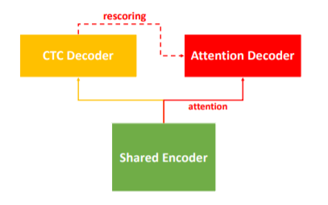
Notes:
Rescoring is revising data.

Slide 11
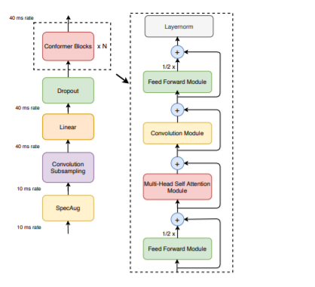
Convolution Encoder
Notes:
Convolution encoders performs better than transformer encoders.

Slide 12
Training
A combined loss with CTC loss and AED loss is adopted in training, as shown in Equation, where x is the acoustic feature, y is the corresponding annotation, LCTC (x, y), LAED (x, y) are the CTC and AED loss respectively, λ is a hyperparameter which balances the importance of CTC and AED loss.
Lcombined (x, y) = λLCTC (x, y) + (1 − λ)LAED (x, y)
Notes:
Loss is the penalty for a bad prediction. That is, loss is a number indicating how bad the model's prediction was on a single example. If the model's prediction is perfect, the loss is zero; otherwise, the loss is greater.

Slide 13
-A dynamic chunk training technique is applied in the training to unify the none streaming and streaming model and enable latency control.
-First, The input is split into several chunks by a fixed chunk size C , the whole latency for the CTC Decoder in the first pass only depends on the chunk size.
-If the chunk size is limited, it works in a streaming way, otherwise, it works in a non-streaming way. Second, the chunk size is varied dynamically from 1 to the max length of the current training utterance in the training, so the trained model learns to predict with arbitrary chunk size. Empirically, a larger chunk size gives better results with higher latency, so we can easily balance the accuracy and latency by tuning the chunk size at runtime

Slide 14
Decoding
Decoding For Python decoding in the research stage, to compare and evaluate different parts of the joint CTC/AED model, WeNet supports four decoding modes as follows:
1. attention: apply standard autoregressive beam search on the AED part of the model.
2. ctc greedy search: apply CTC greedy search on the CTC part of the model, CTC greedy search is super faster than other modes.
3. ctc prefix beam search: apply CTC prefix beam search on the CTC part of the model, which can give the n-best candidates.
4. attention rescoring: first apply CTC prefix beam search on the CTC part of the model to generate n-best candidates, and then rescore the n-best candidates on the AED decoder part with corresponding encoder output.
For decoding in the runtime stage, the only attention rescoring is supported since it’s our ultimate solution for production.

Slide 15
2. System Design
The whole framework is fully based on PyTorch and it’s an ecosystem as the bottom stack
The second stack consists of two parts. Python (TorchScript) Research is for developing a research model, TorchScript is used to ensure the model could be correctly exported as a production model. LibTorch Production is for hosting production model, which is designed to support various hardware and platforms like CPU, GPU (CUDA) Linux, Android, and IOS.
The third stack shows typical research to production pipeline in WeNet
Notes:
n, TorchScript is used for developing model, Torchaudio is used for on-the-fly feature extraction, DistributedDataParallel is used for distributed training, torch JIT (Just In Time) is used for model exportation, PyTorch quantization is used for the quantized model, and LibTorch is used for production runtime.

Slide 16
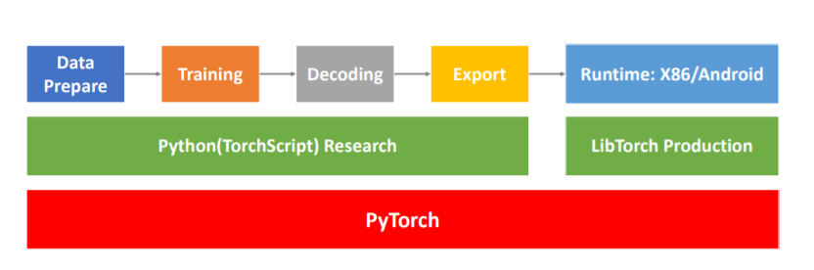

Slide 17
Data prepare:
Data prepare in WeNet is pretty simple, a Kaldi style label file and wave list file, the model unit dictionary file which maps model unit to corresponding integer id, are all you need
Training:
The training stage in WeNet has the following key features: On-the-fly feature extraction: this is based on Torchaudio, which can generate the same FBANK feature as Kaldi.
Decoding:
A set of Python tools are provided to recognize the wave files and compute the accuracy. These tools help users validate and debug the model before deploying it in production.
Export:
For WeNet model is implemented in TorchScript, it could be exported by torch JIT to the production model directly and safely. Then this exported model can be hosted by using the LibTorch library in runtime
Notes:
Kaldi is an open-source speech recognition toolkit written in C++ for speech recognition and signal processing,
fbank - feature extraction.

Slide 18
Experiments:
WeNet carry out their experiments on the open-source Chinese Mandarin speech corpus AISHELL-1[23], which contains a 150- hour training set, a 10-hour development set, and a 5-hour test set. The test set contains 7176 utterances in total. We use 80 dimensional log Mel-filter bank (FBANK) computed on-the-fly by Torchaudio with a 25ms window with a 10ms shift as the feature.
Notes:
12 transformer layers for the encoder and 6 transformer layers for the decoder have been used.

Slide 19
1. Unified model evaluation
We first trained a non-streaming model (M1) as our baseline, the model is trained and inferenced by full attention. Then we trained a unified mode (M2) with a dynamic chunk strategy. M2 is inferenced with different chunk sizes full/16/8/4 at decoding, full is for full attention non-streaming case, 16/8/4 is for the streaming case.

Slide 20
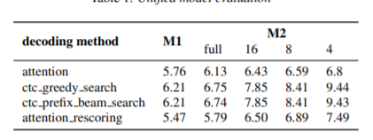
So the dynamic chunk based unified model with attention rescoring decoding is our choice for production, resulting in only the attention rescoring mode is supported in our runtime.

Slide 21
2. Runtime benchmark
This section shows the quantization, RTF, and latency benchmark on the unified model M2 described above. We do our benchmark on a server x86 platform, an on-device ARM Android platform respectively.
Notes:
For the cloud x86, the CPU is 4 cores Intel(R) Xeon(R) CPU E5-2620 v4 @ 2.10GHz, the memory is 16G in total
The digitization of analog signals involves the rounding off of the values which are approximately equal to the analog values. The method of sampling chooses a few points on the analog signal and then these points are joined to round off the value to a near stabilized value. Such a process is called as Quantization.(rounding off)
RTF stands for runtime fabric

Slide 22

Quantization
Here we just compare the CER difference before and after quantization.
Notes:
character error rate (CER)

Slide 23
RTF
RTF increases as the chunk size decreases since the smaller chunk requires more iterations for the forward computation.
Latency
For latency benchmark, we create a WebSocket server/client to simulate a real streaming application. This benchmark is only carried out on the server x86 platform. The average latency we evaluated is described here:

Slide 24
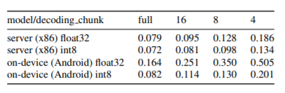
1. model latency (L1): the wait time introduced by the model structure. for our chunk based decoding, the average wait time is half of the chunk. And the total model latency of our model is (chunk/2 ∗ 4 + 6) ∗ 10 (ms), where 4 is the subsampling rate, 6 is the lookahead introduced by the first two CNN layers in the encoder, 10 is the frame shift.
2. rescoring cost (L2): the time cost on the second pass attention rescoring.
Notes:
Cnn-convolution neural network

Slide 25
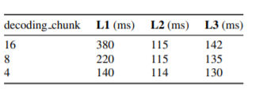
3. final latency (L3): the user (client) perceived latency, which is the time difference between the user stopping speaking and getting the recognition result. When our ASR server receives the speech stopping signal, it first forwards the left speech for CTC searching, then does the second pass attention rescoring, so rescoring cost is part of the final latency. The network latency should be also taken into account for a real production, however since we tested the server/client in the same machine, so the network latency is negligible.

Slide 26
Strategy to implement:
Dataset-
-AIShell-1
-LibriSpeech
I will use PyTorch module of python to create the simulation similar to End-to-End ASR model of WeNet and use the given data-set to check the performance of the E2E model using custom example. (Pytorch ecosystem)
Implementation points-
Joint CTC/AED model structure
U2, dynamic chunk training
Torchaudio
Several runtimes will be implemented to show how to host WeNet trained models on x86 platform.

Slide 27
Conclusion:
WeNet present a new open source E2E speech recognition toolkit, which is production first and production ready, provides a unified solution for streaming and non-streaming application, benchmarks the accuracy, RTF and latency. The whole toolkit is well designed, lightweight, and it shows great performance.

Slide 28
Bibliography
-https://arxiv.org/abs/2005.08100(conformer info and diagram).
-https://pytorch.org/(pytorch info)
-https://machinelearningmastery.com/define-encoder-decoder-sequence-sequence-model-neural-machine-translation-keras/
-https://kaldi-asr.org/doc/about.html
-www.wikipedia.com
-https://github.com/espnet/espnet(ASR model)

